Slide 1

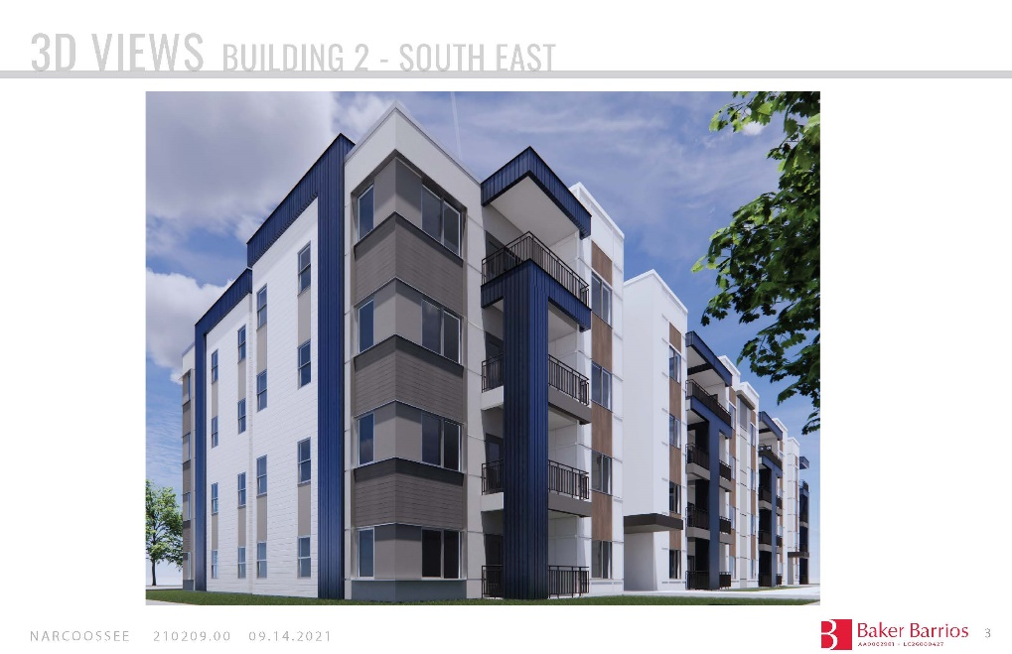
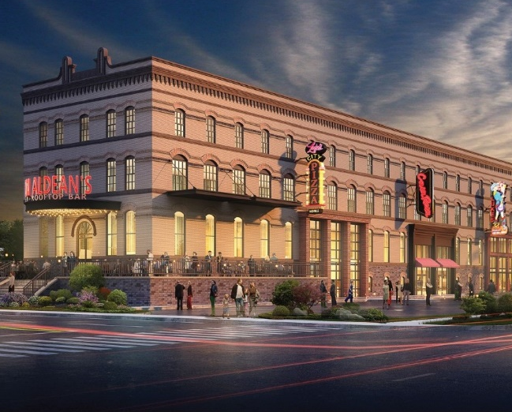
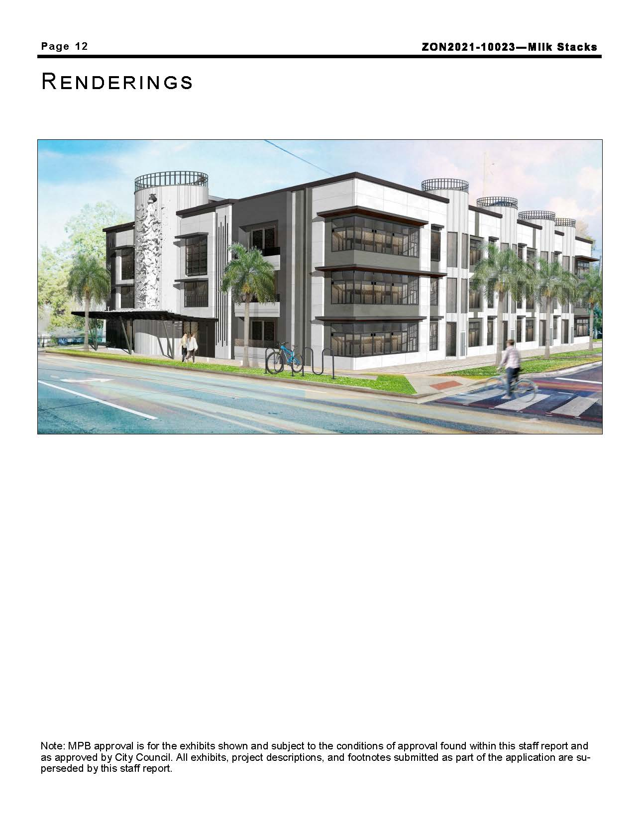
Firm Introduction and Overview of Upcoming Projects
January 12, 2022
ABC Builders’ Breakfast

Slide 2

About Atrium
Company Highlights:
  20+ Years in Business
  2,500 Residential Units Owned and/or Managed
  State-of-the-Art Real Estate Technology to Increase Efficiency and Elevate Tenant Living
  Extensive Vendor Network, allowing Clients to Access more Services at Lower Prices
Atrium Management Company has been providing best-in-class professional Development, Asset and Property Management Services to clients and investors throughout Florida for over 20 years. Serving key strategic areas, Atrium provides the most comprehensive coverage available in the cities of Orlando, Tampa, Gainesville and their surrounding Central Florida communities. Atrium takes a team based approach to its business, which allows it to maintain a small company feel and customer focus as the company continues to grow and expand.
Atrium’s mission is to use a combination of cutting-edge technology, considerable experience, and world-class personal service to improve bottom line performance for our clients and to provide residents with an excellent living experience. When you work with Atrium Management Company, you can expect an honest and dependable team. Our goal is to exceed the expectations of our clients and consistently raise the bar for the industry.
www.atriummanagement.com

Slide 3
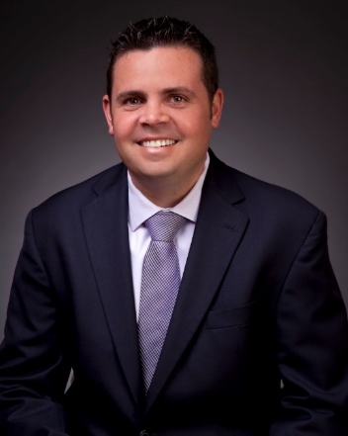
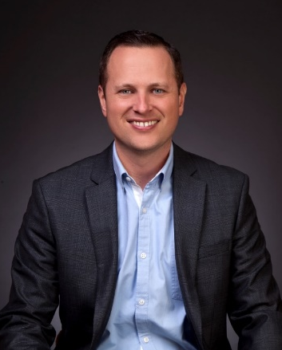

About Atrium
Adam Wonus
Email: awonus@atriummanagement.com
Michael Krause
Email: mkrause@atriummanagement.com
Adam began his career as an underwriter at Mercantile Commercial Capital where he financed over $120,000,000 worth of projects. He eventually moved on to Wells Fargo and later CBRE where he was tasked with starting a national small business lending platform for the firm. In 2012 Adam created A.T. Wonus Development Group, where he developed over $20,000,000 worth of new construction in Central Florida. In 2014 Adam purchased Atrium Management Company with Michael and has been focused on building and expanding the business as the premier vertically integrated real estate services company.
Michael began his career in property management in 2003 at AIMCO, where he worked his way up from an entry level position to property manager. In 2008, the property he was managing was acquired by JRK Residential, an L.A. based P.E. company. In 2011 he was promoted to Area Manager of Central Florida and eventually Regional Manager covering the Eastern U.S. Over his 17 years in property management, Michael has managed over 15,000 units across 22 different states. He has always put a strong emphasis on team building and creating a positive working environment and one of his key focuses is bringing the best talent to Atrium.
www.atriummanagement.com

Slide 4


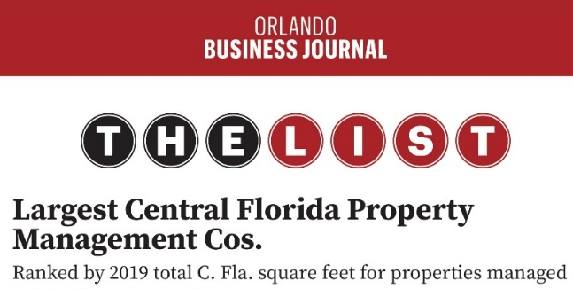



Company Recognition
www.atriummanagement.com

Slide 5
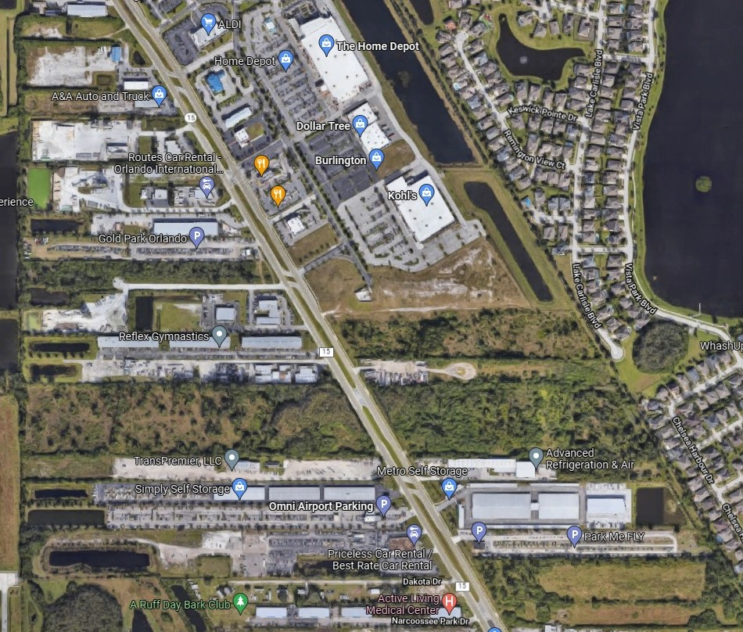
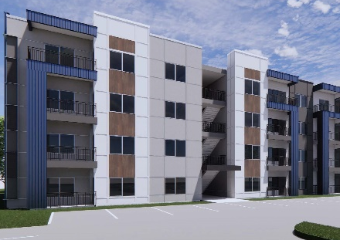
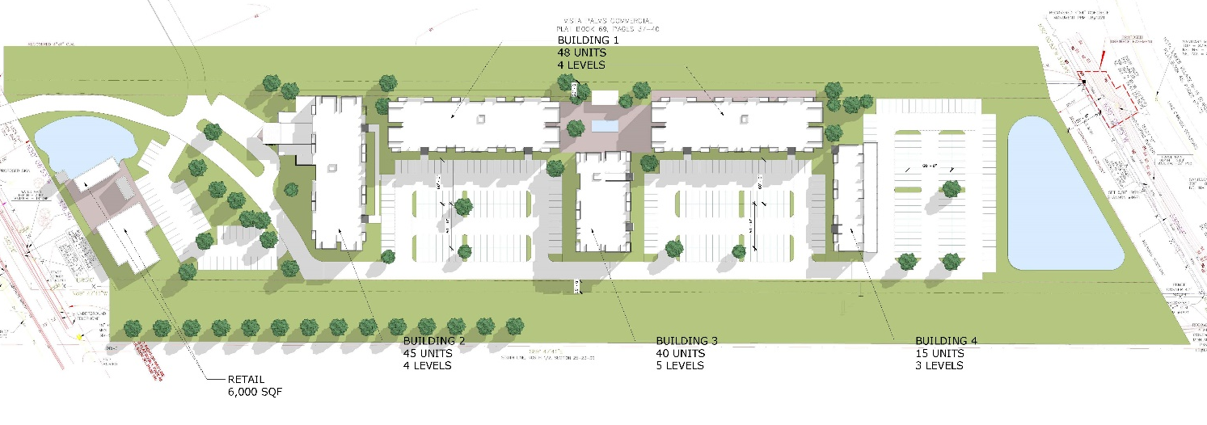
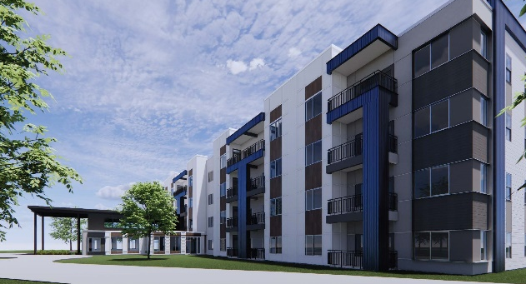
Project: 7445 Narcoossee Multifamily
Project Name: 7445 Narcoossee Multifamily
Type: 195 Unit Multifamily Development
Market: Lake Nona
Address: 7445 Narcoossee Rd Orlando, FL
Estimated Project Cost: $51MM

Slide 6
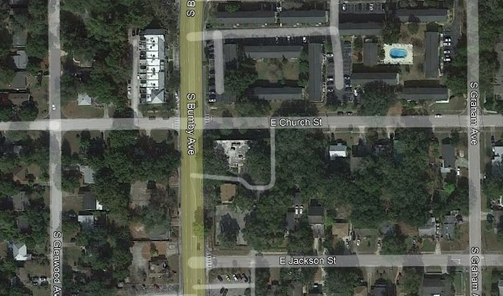
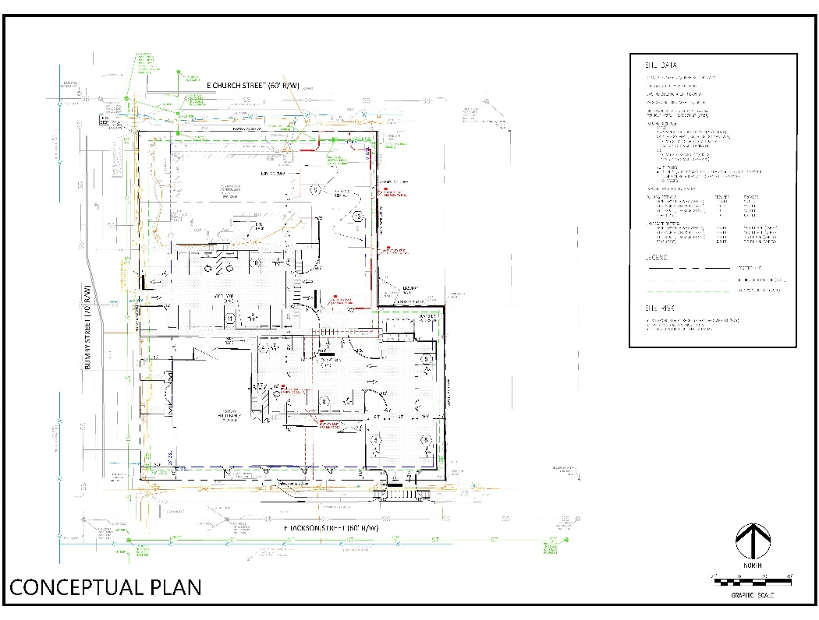
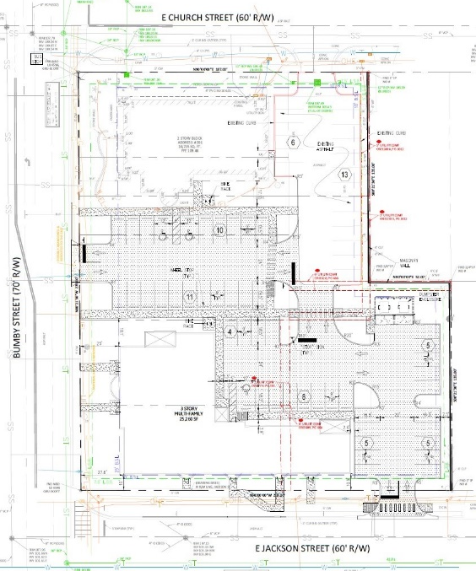
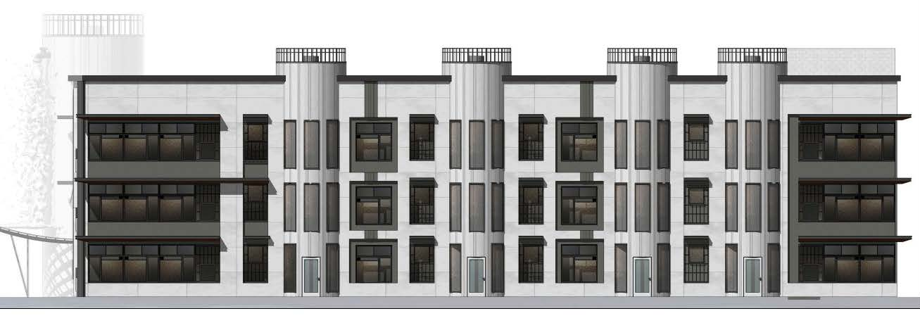
Project: Milk Stacks Apartments
Project Name: Milk Stacks Apartments
Type: 27 Unit Apartment Project (Inc. 2 Live-Work Units)
Market: Downtown Orlando – Milk District
Address: 201 S Bumby Ave, Orlando, FL 32801
Estimated Project Cost: $6MM

Slide 7
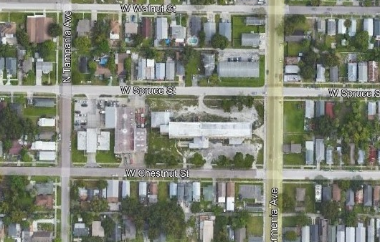
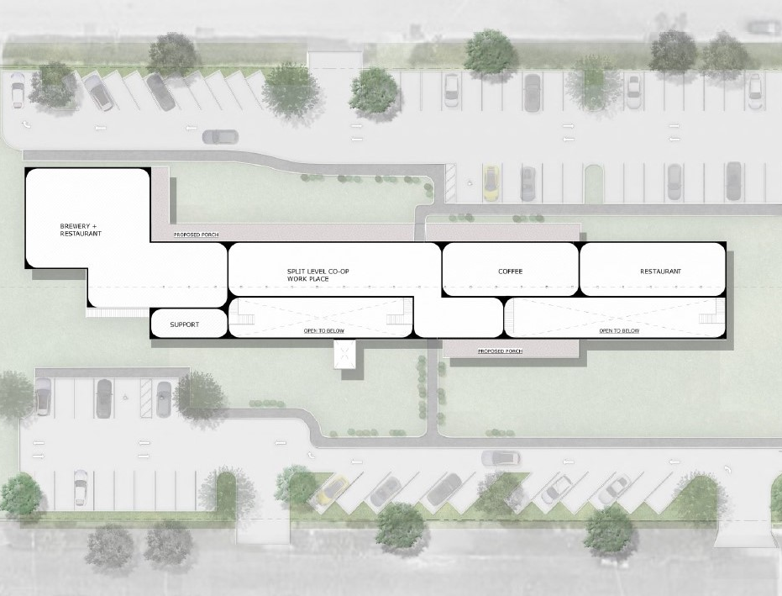

Project: Armenia Cigar Factory
Project Name: Armenia Cigar Factory
Type: Adaptive Reuse of Historic Cigar Factory
Market: Downtown Tampa – N Hyde Park
Address: 1906 N Armenia Ave, Tampa, FL 33607
Estimated Project Cost: $15MM

Slide 8
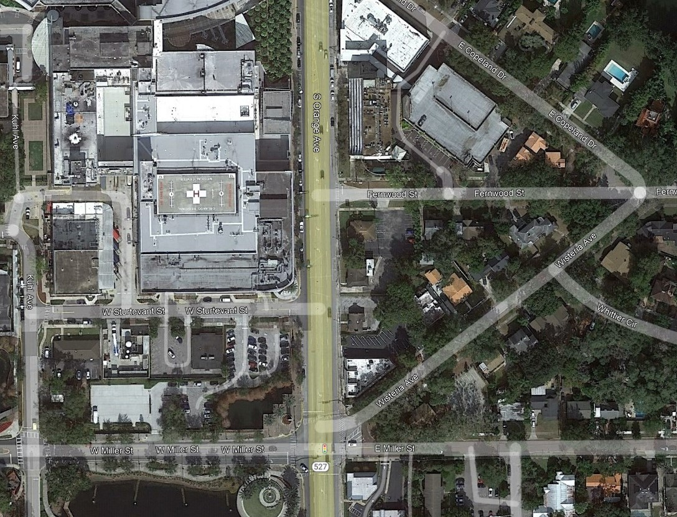
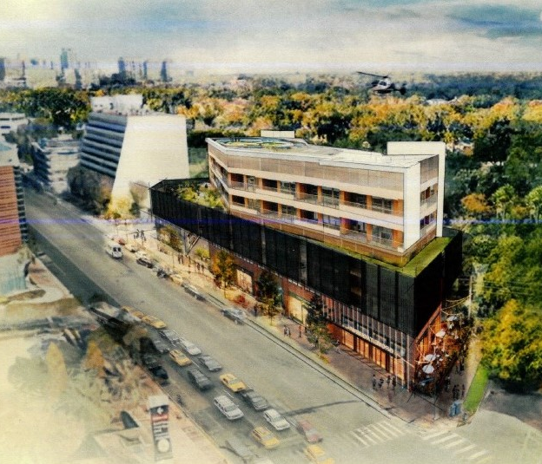
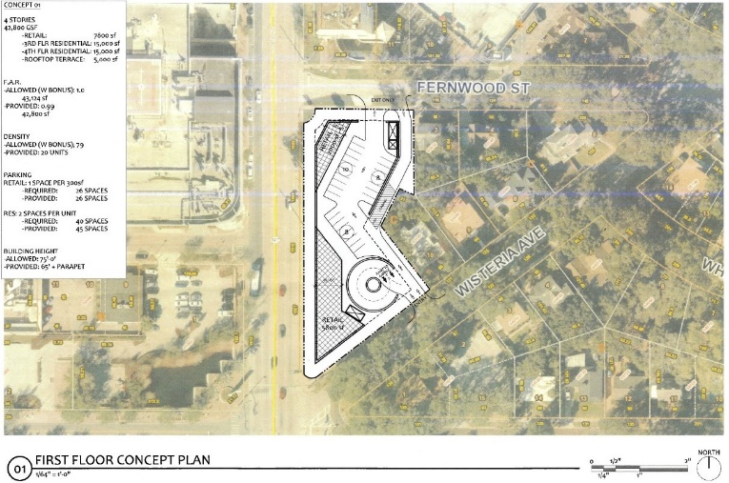
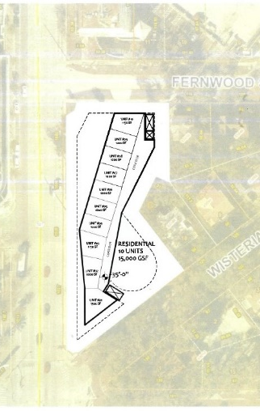
Project: Orange Avenue Mixed-Use
Project Name: Orange Avenue Mixed-Use
Type: ~20 Residential Units and 8,000 SF Retail
Market: Downtown Orlando – SODO District
Address: 1509 S Orange Ave, Orlando, FL 32806
Estimated Project Cost: $7-9MM

Slide 9
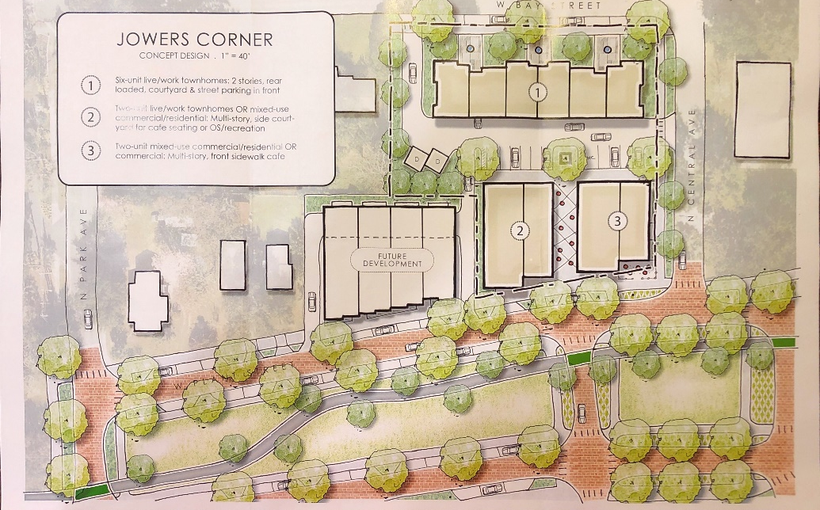
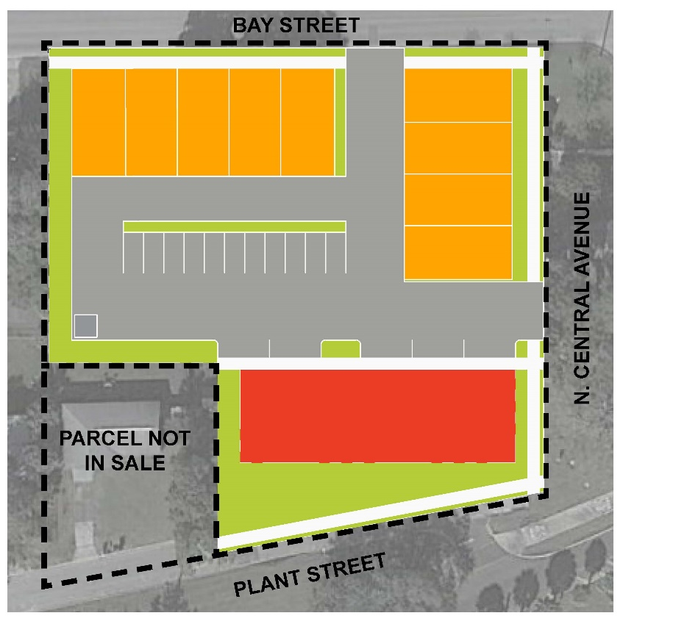
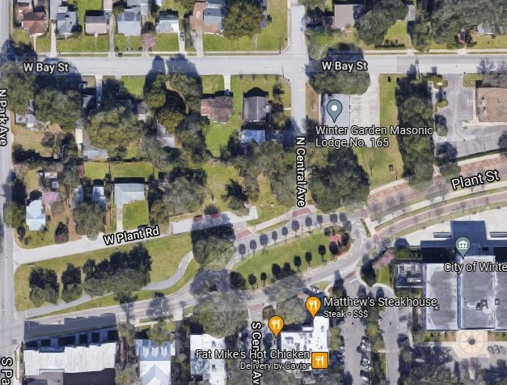

Project: Winter Garden Mixed-Use
Project Name: Winter Garden Mixed-Use
Type: 6-9 Townhomes with 4-6k SF of Retail/Office
Market: Downtown Winter Garden
Address: 419 W Plant St, Winter Garden FL
Estimated Project Cost: $4.5MM
Potential Site Plans

Slide 10
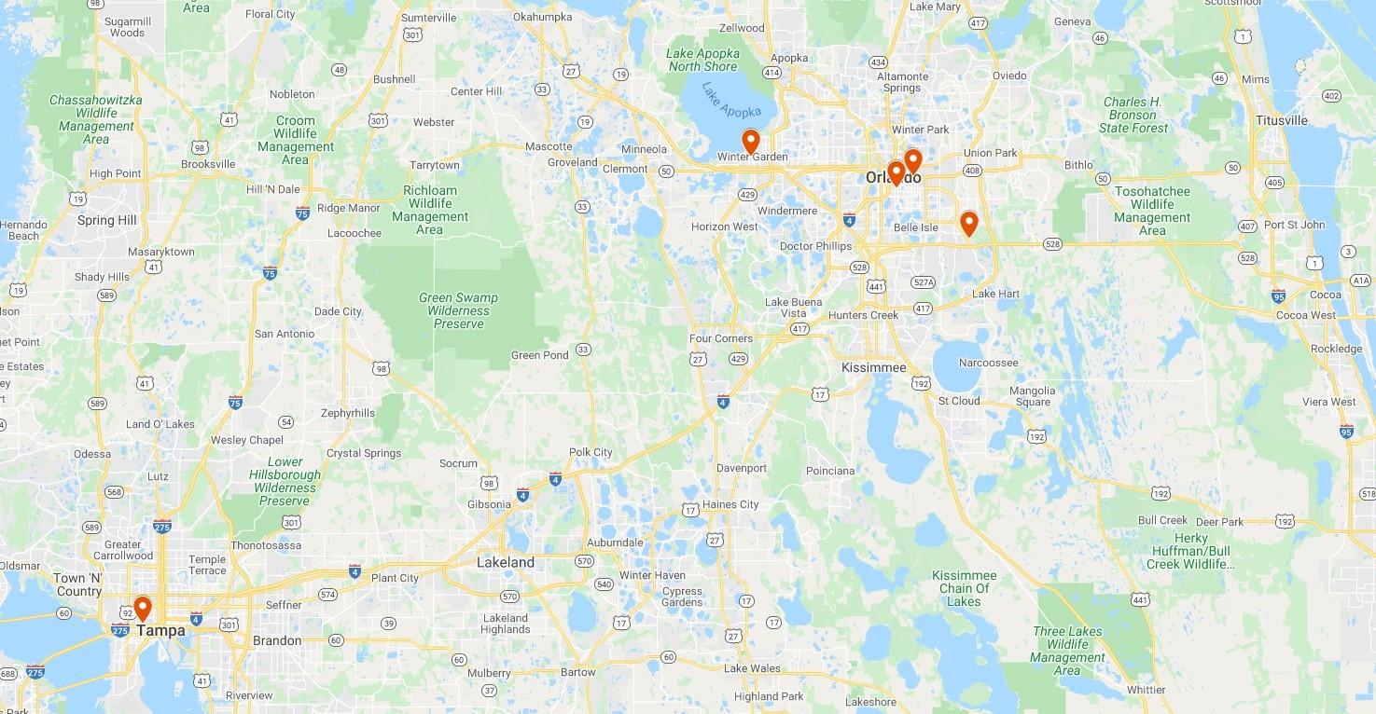
Pipeline Overview
2022 DEVELOPMENT PIPELINE
5 Active Projects
251 Residential Units
75,000 SF Commercial Space
$85,500,000 Estimated Project Cost

Slide 11
Firm Introduction and Overview of Upcoming Projects
January 12, 2022
ABC Builders’ Breakfast

